Slide 1
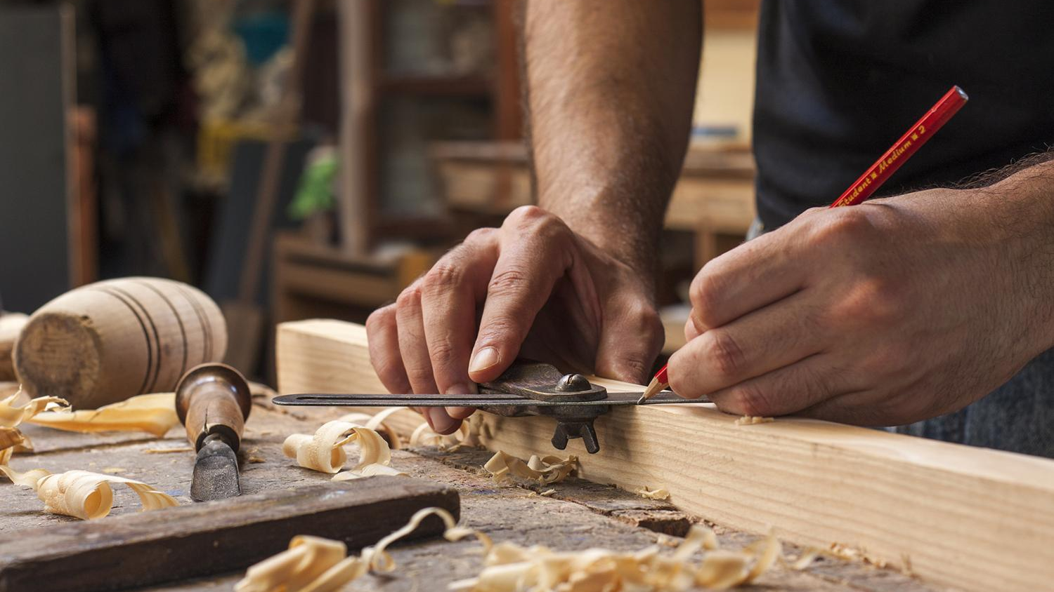
Spinning Top
Construction Journal
Abhiraj Dhillon

Slide 2
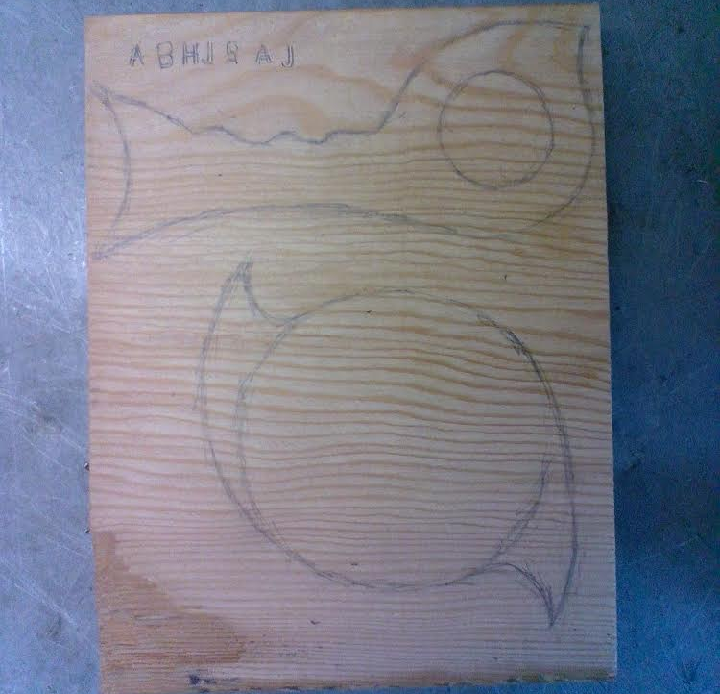
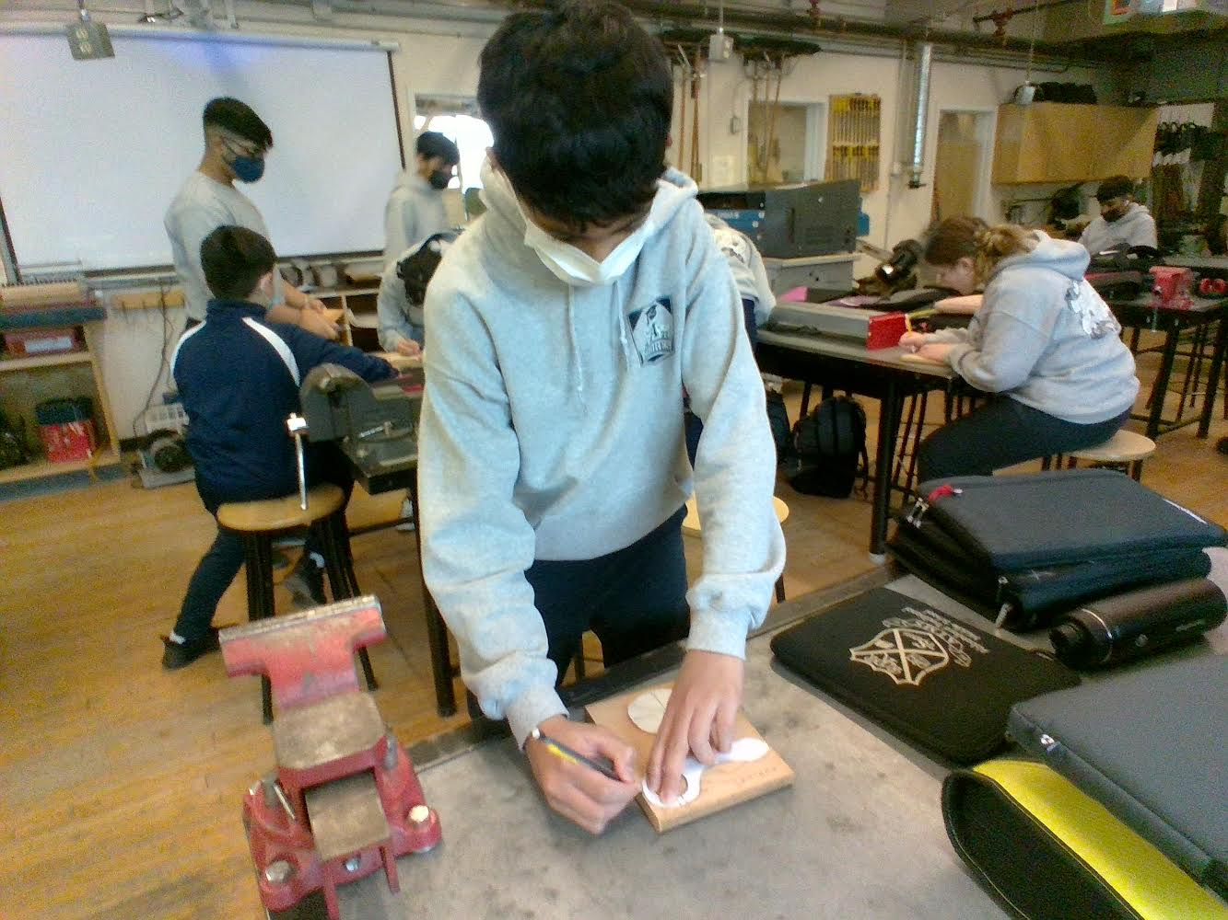
Drawing the Shapes
Many people had chosen to not do a custom shape, but I took the more difficult path and did a custom shape. For my handle, I had taken inspiration from the show, The Mandolorian. Specifically the stock of his gun. I also choose to add grooves for my hand to fit in. The rest was just a custom look and I tried to make it sleek as possible. The actual spinning top wasn’t changed too much. It was just the circle shape with spikes added to it. It made it look cooler and it does more damage to other spinning tops. In fact, after I had finished the top, I had a deul with my friend, his top ended up getting launched off the table.

Slide 3
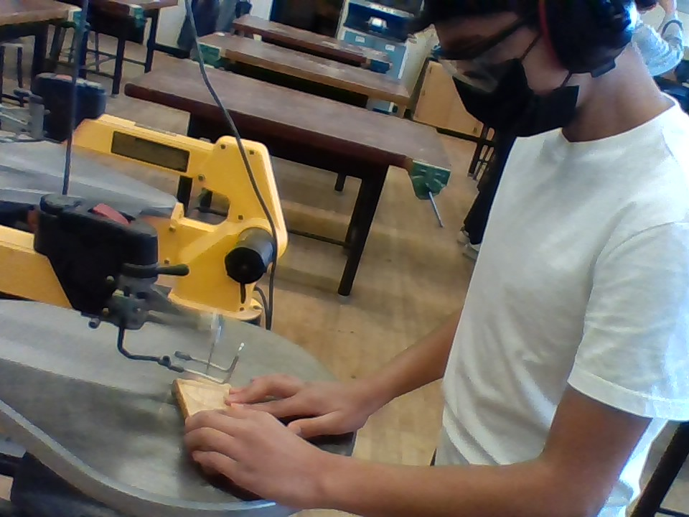
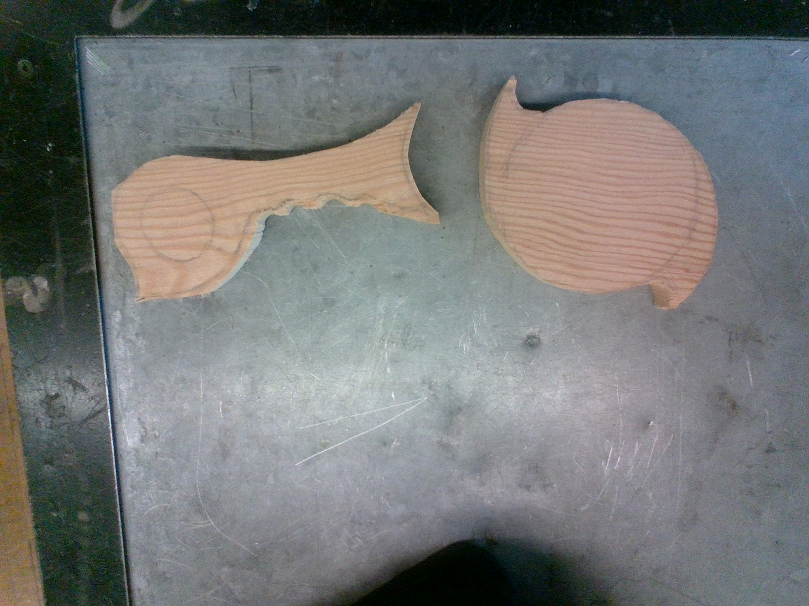
Cutting Out the Shapes
The cutting process was pretty easy for me as I have used a scroll saw before. I used it last year during the wooden car project. So it was fairly easy for me. I knew what to do on turns. (Go back and forth to cut out wood until you have enough space to turn your blade). I also had good control caue of my experience. These were the shapes after I had finished cutting them out. I had done a very rough cut, as I planned to sand it a lot later. This would give me a more accurate and better end result. If I had gone on the line, I could’ve messed up and taken off more than I needed too, this gave me space to work with.

Slide 4
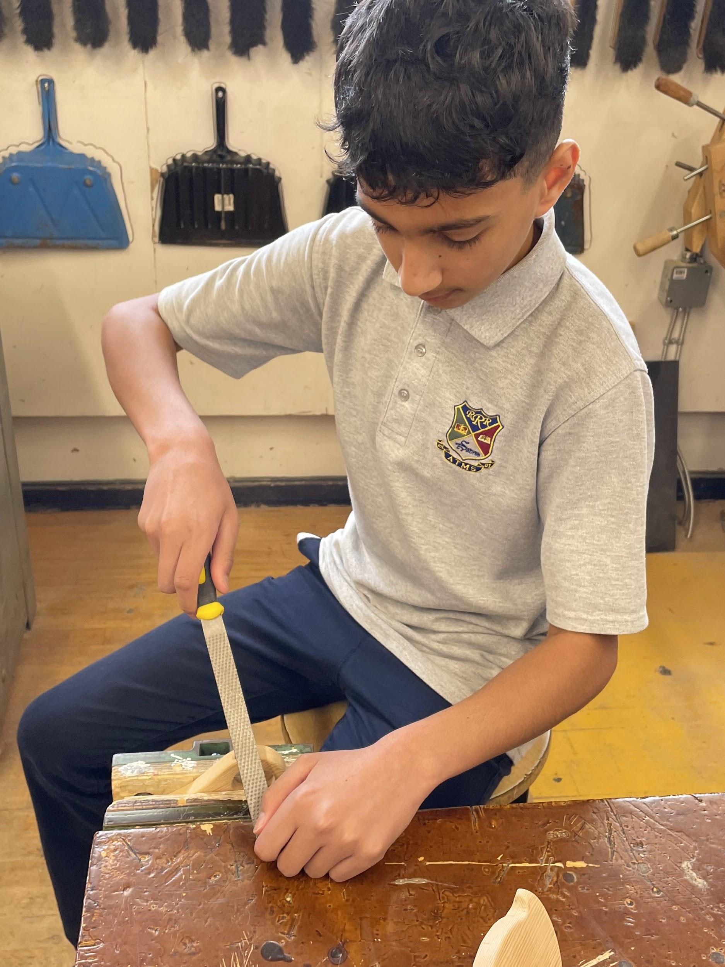
Mistakes of
Using a Rasp
I had done a rough cut of my shape. So, to shave wood off, I used a rasp. But, that was a mistake. It was shaving off wood just fine at the start. Then, I ended up taking a huge chip off of my handle. It was around the top of the round part, not the actual handle. This caused me to have to sand it a lot in that area, so it is more angled in that one area. I had also tried to use a circular rasp to make the grooves. This also took off multiple chips off the higher parts of the grooves. So in these areas, I was forced to do the same thing and you can tell, as they are more angled inwards. I had tried getting the other side, to look similar to make it not as obvious and it ended up working, so I was very happy with it.

Slide 5
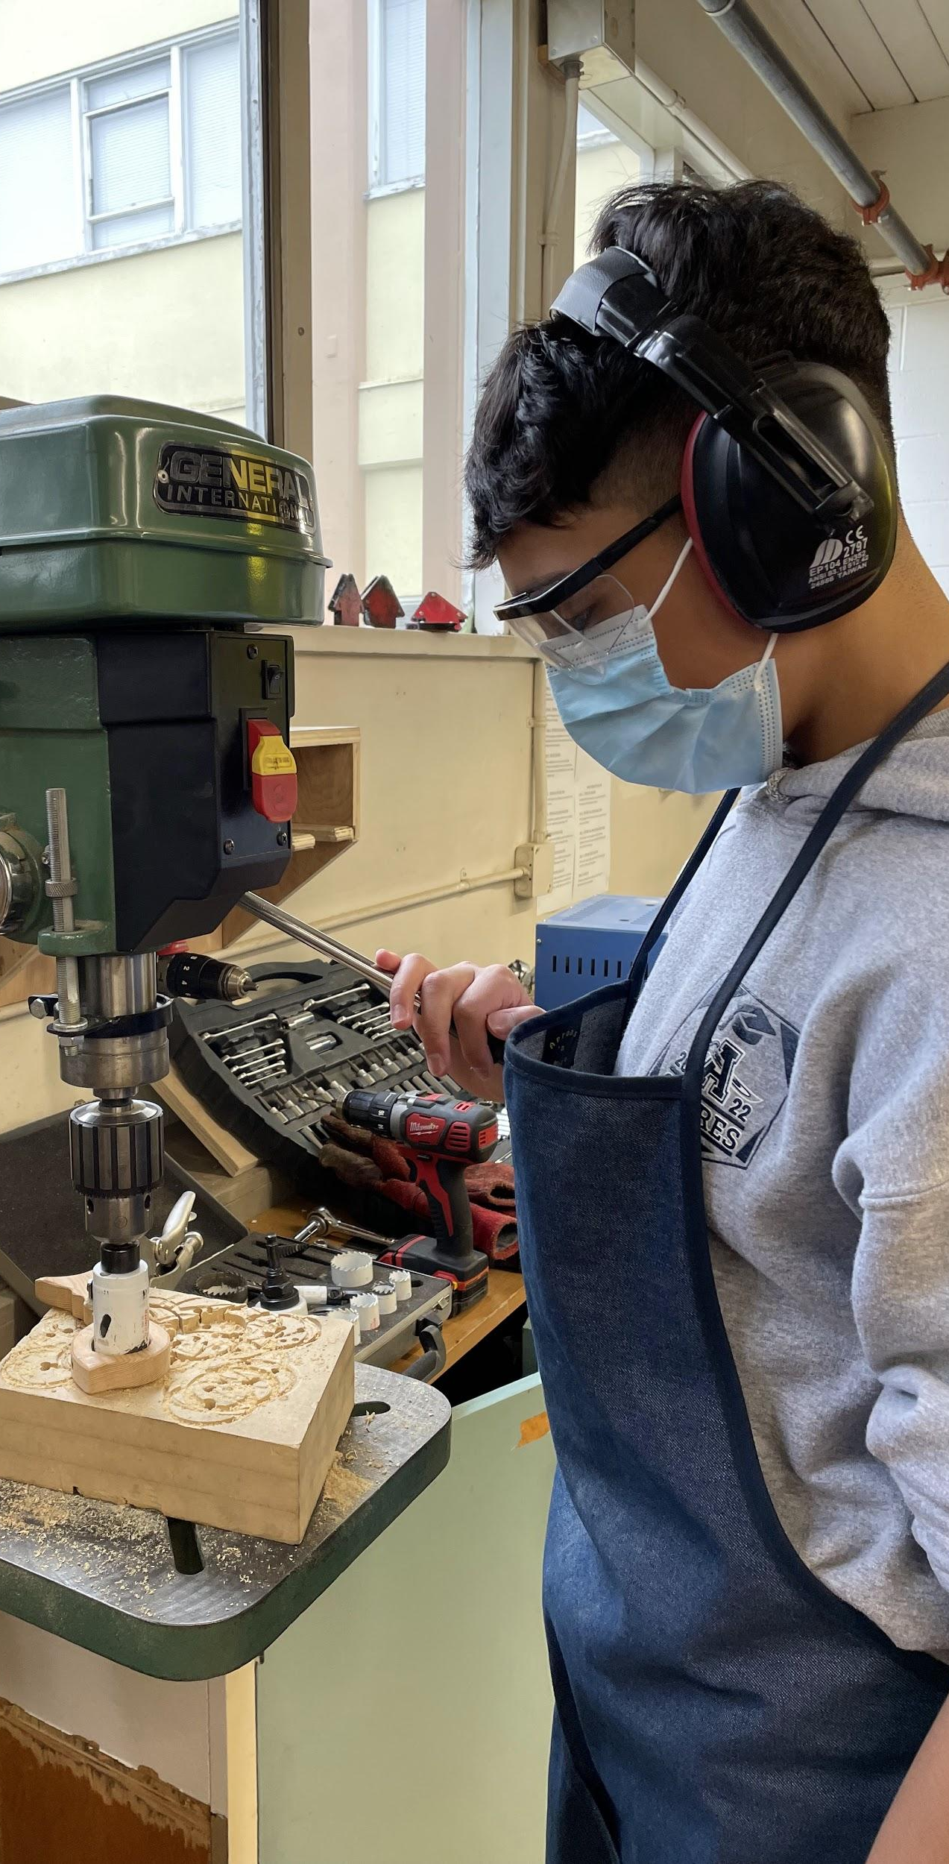
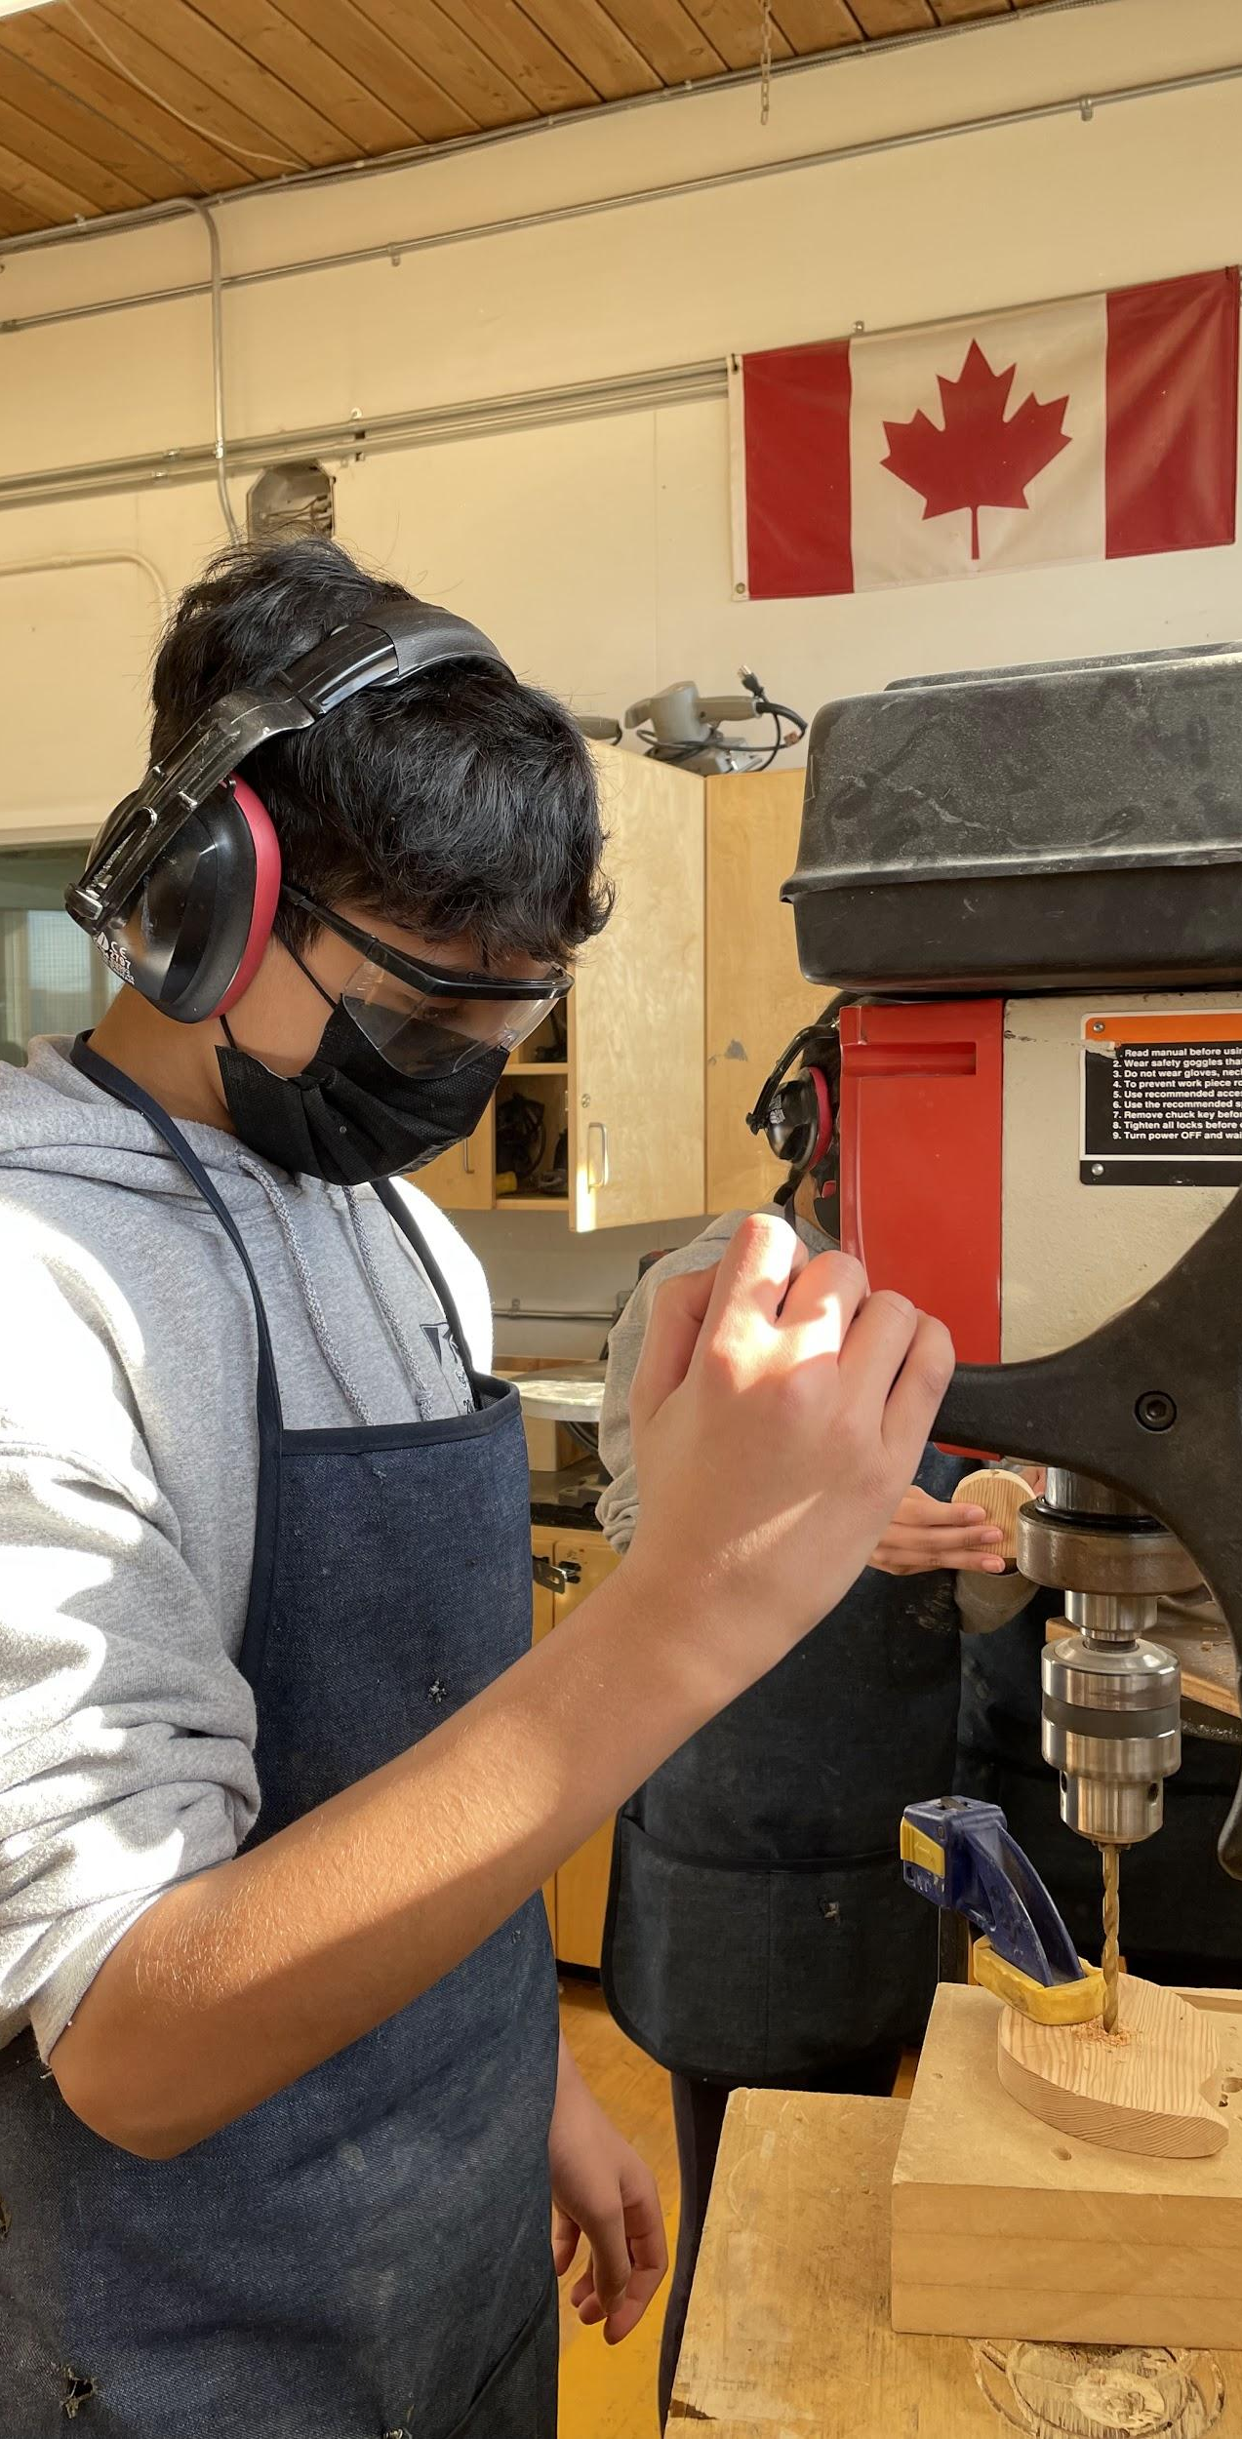
Drilling Holes
I didn’t have any issue drilling holes. This was mostly due to me have used the drill press last year. I knew to drill by going up and down and not forcing it. I knew when to stop, as the shavings colours would change. I had managed to cut out the circle perfectly. This was due to me marking the center perfectly and because I did the method of only going half way in and flipping it. Which helped with chipping, which would make me waste time, as I would have to sand it out.

